Slide 1

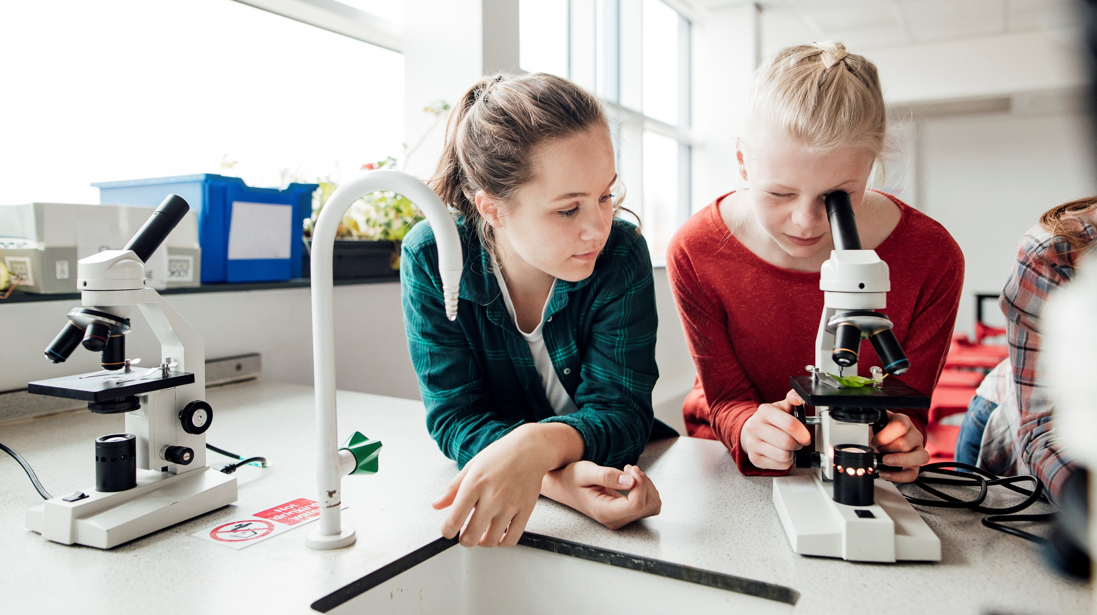
Car plate reorganization based on CNN

Slide 2
contents
Abstract
Introduction of CNN
Introduction of TensorFlow
Code analyze
Summary and prospect
Reference
Introduction of the system
Study background

Slide 3
Abstract
This system implements a car plate recognition system, which consists of car plate location, character recognition, and convolution neural network training and recognition module.
Experimental results show that compared with other single function methods, the CNN method can reach a higher accuracy and lower loss rate.

Slide 4
Study background
As a core component, Automatic License Plate Recognition (ALPR) plays an important role in modern Intelligent Transportation System (ITS). Due to the complexity in real world, many existing license plate detection and recognition approaches are not robust and efficient enough for practical applications, therefore ALPR still a challenging task both for engineers and researchers.
License plate recognition mainly includes license plate location, character segmentation, and recognition of character. In the residential district vehicle access management, the expressway toll has been widely used.

Slide 5
Introduction of the system
This is a car plate recognition core system. It includes the core function of car plate recognition but does not include the application like user interface, package distribution and installation, and hardware utilization.
We need to train the model for car plate and character recognition separately. The training dataset can fetch from CCPD (Chinese City Parking Dataset, ECCV).
Once the model is trained. We then can start to identify car plates. We just move the image to the specific directory, run the identification program and it will print out the identification result.
This system succinctly takes license plate detection and recognition as two associated parts and is trained end-to-end.

Slide 6
INTRODUCTION OF CNN
In deep learning, a convolutional neural network (CNN, or ConvNet) is a class of artificial neural network (ANN), most applied to analyze visual imagery.
It based on the shared-weight architecture of the convolution kernels or filters that slide along input features and provide translation-equivariant responses known as feature maps.
CNNs are regularized versions of multilayer perceptrons. Multilayer perceptrons usually mean fully connected networks, that is, each neuron in one layer is connected to all neurons in the next layer.
Convolutional networks were inspired by biological processes in that the connectivity pattern between neurons resembles the organization of the animal visual cortex.
Individual cortical neurons respond to stimuli only in a restricted region of the visual field known as the receptive field. The receptive fields of different neurons partially overlap such that they cover the entire visual field.

Slide 7
Principles OF CNN
A typical CNN consists of 3 parts: Convolution layer, Pooling layer and Fully connected layer
The convolutional layer is responsible for extracting local features in the image; the pooling layer is used to significantly reduce the parameter magnitude; the fully connected layer is similar to the traditional neural network portion and is used to output the desired result.

Slide 8
Convolution - extraction features
The operation of the convolutional layer is as shown in the figure, using a convolution kernel to scan the entire picture:
This process we can understand is that we use a filter (convolution kernel) to filter the small areas of the image to get the eigenvalues ​​of these small areas.
After passing through a convolutional layer, the image becomes abstracted to a feature map, also called an activation map, with shape: (number of inputs) x (feature map height) x (feature map width) x (feature map channels).

Slide 9
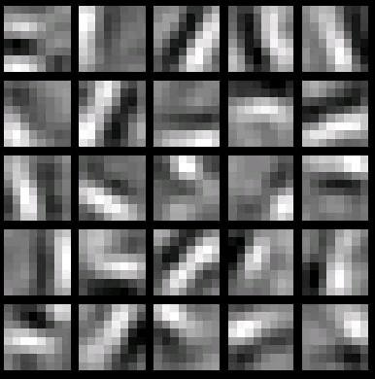
Convolution - extraction features
In a specific application, there are often multiple convolution kernels. It can be considered that each convolution kernel represents an image mode. If an image block is convolved with the convolution kernel, the image block is considered to be Very close to this convolution kernel. If we design 6 convolution kernels, we can understand that we think there are 6 underlying texture patterns on this image, that is, we can draw an image using the basic mode in 6. The following are examples of 25 different convolution kernels:

Slide 10
Pooling - dimensionality reduction
The pooling layer is simply a downsampling, which can greatly reduce the dimensions of the data. The process is as follows
The reason for this is that even after the convolution is done, the image is still large (because the convolution kernel is small), so in order to reduce the data dimension, the downsampling is performed.

Slide 11
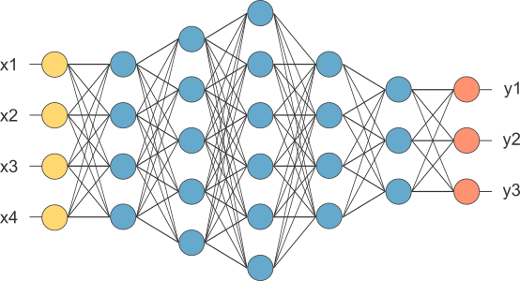
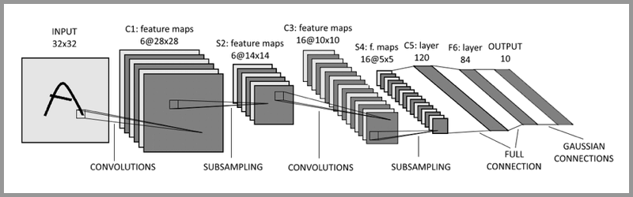
Fully connected layer - Classification
Fully connected layers connect every neuron in one layer to every neuron in another layer. It is the same as a traditional multilayer perceptron neural network (MLP). The flattened matrix goes through a fully connected layer to classify the images.
A typical CNN is not just the 3-layer structure mentioned above, but a multi-layer structure, such as the structure of LeNet-5

Slide 12
Introduction of TensorFlow
TensorFlow is a free and open-source software library for machine learning and artificial intelligence. It can be used across a range of tasks but has a particular focus on the training and inference of deep neural networks.
TensorFlow was developed by the Google Brain team for internal Google use in research and production. Google released the updated version of TensorFlow, named TensorFlow 2.0, in September 2019.
TensorFlow can be used in a wide variety of programming languages, most notably Python, as well as Javascript, C++, and Java. This flexibility lends itself to a range of applications in many different sectors.
In our system, we will use the TensorFlow library and python to implement our system.

Slide 13
Code analyze
Data set
Training
Testing
Preprocessing
Locating
recognition

Slide 14
Repository address – https://github.com/XIAOCHONG-LIN/CarPlateRecognizationCNN
carPlateIdentity.py – the main module for identify the car plate
charNeuralNet.py – the training module for identify the character of car plate
plateNeuralNet.py – the training module for identify the car plate image
carIdentityData – the training dataset category
Images – the identify module image category

Slide 15
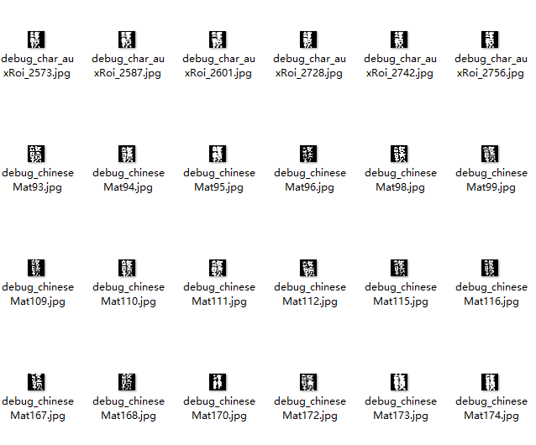
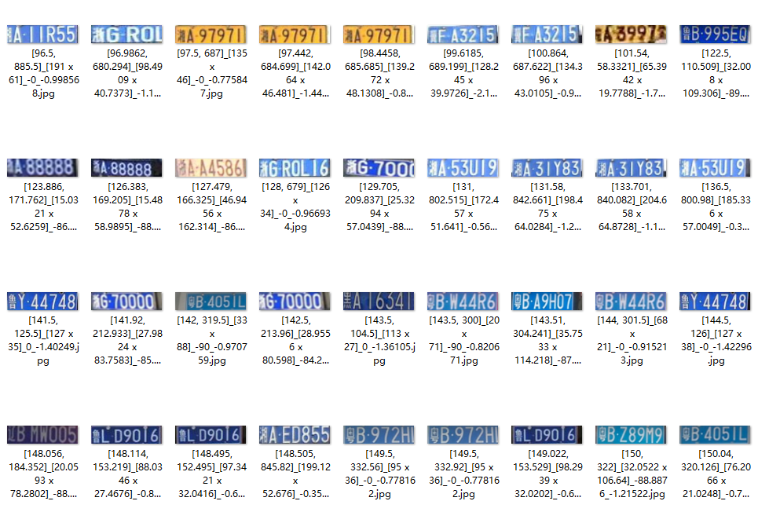
Code analysis – data set
We use CCPD (Chinese City Parking Dataset, ECCV) as the training and testing dataset.
Dataset includes five directories
Character training dataset
Character testing dataset
Car plate training dataset
Car plate testing dataset
The model is stored in ‘model’ sub directory.

Slide 16
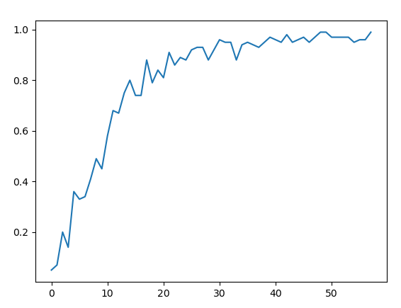
Code analysis Training – character
Initial data
Split the train data and test data
Construct CNN layers
Soft max normalization
Set the rule of accuracy calculation
Set the rule of the cost calculation
Set the train step
Start training
in around 500 steps, the accuracy converges to higher than 99%

Slide 17
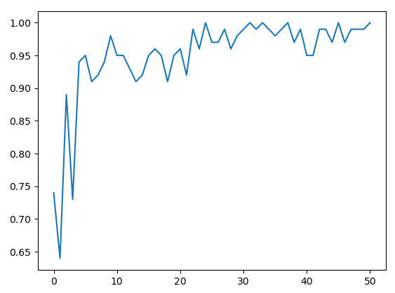
Code analysis Training – car plate
Initial data
Split the train data and test data
Construct CNN layers
Soft max normalization
Set the rule of accuracy calculation
Set the rule of the cost calculation
Set the train step
Start training
in around 250 steps, the accuracy converges to higher than 99%

Slide 18
Code analysis testing – character
Initial data
Construct cnn layers
Softmax normalization
Set the predicted axis
Start testing
total: 549 incorrect: 26
Accuracy rate: 0.9526411657559198

Slide 19
Code analysis testing – car plate
Initial data
Construct cnn layers
Softmax normalization
Set the predicted axis
Start testing
total: 200
incorrect: 62 0.6388506
incorrect: 77 0.72059715
incorrect: 147 0.83242637
contains car plate:98, no car plate:99
Accuracy rate: 0.985

Slide 20
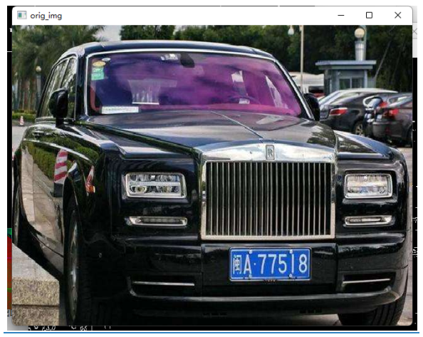
Code analysis – processing image
Convert to grayscale

Slide 21
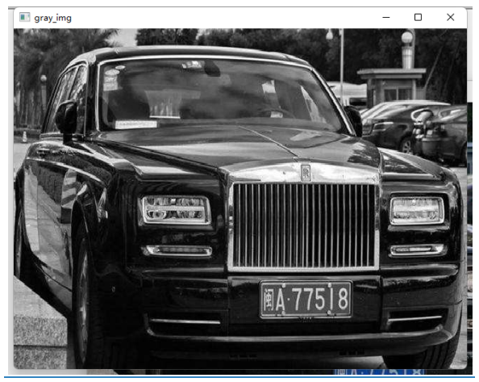
Code analysis – processing image
Gaussian blue
kernel size 5

Slide 22
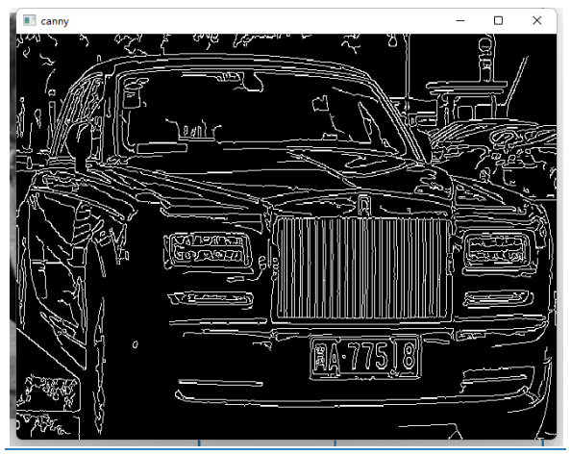
Code analysis – processing image
Canny edge finding
low threshold = 50
Hight threshold = 150

Slide 23
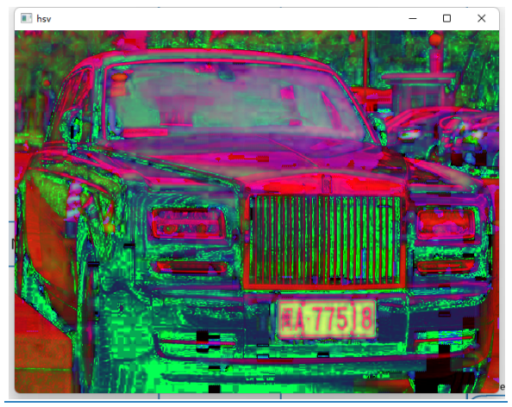
Code analysis – processing image
Convert to hsv image to get h, s, v data

Slide 24
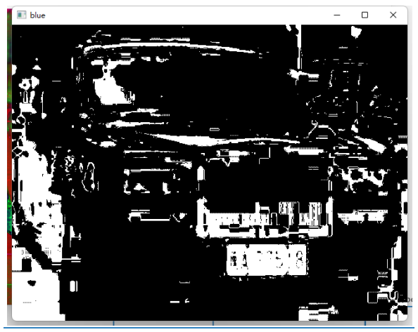
Code analysis – processing image
Find blue area
Range between 100, 124

Slide 25
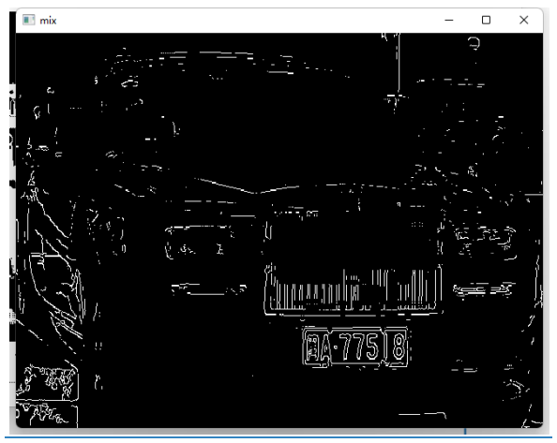
Code analysis – processing image
Find the blue edge

Slide 26
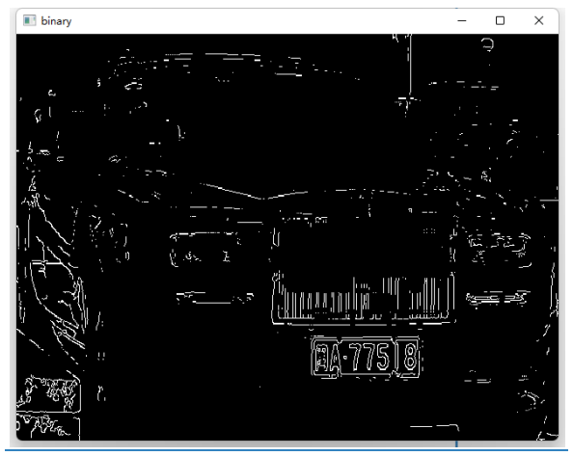
Code analysis – processing image
Binarization

Slide 27
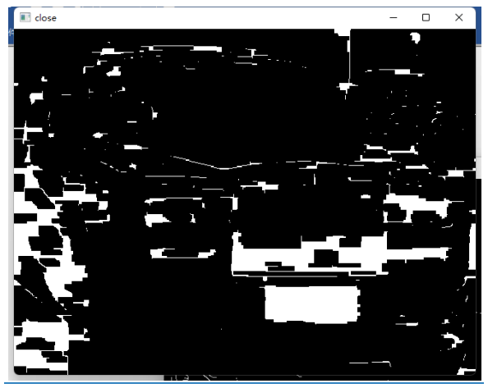
Code analysis – processing image
Morphology

Slide 28
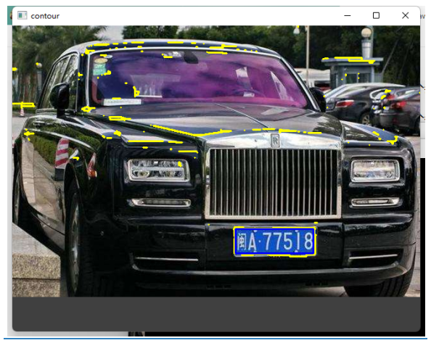
Code analysis – locate car plate
Find contours

Slide 29
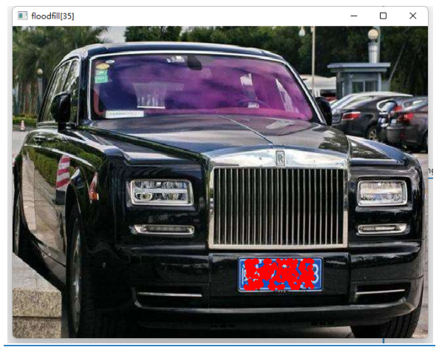
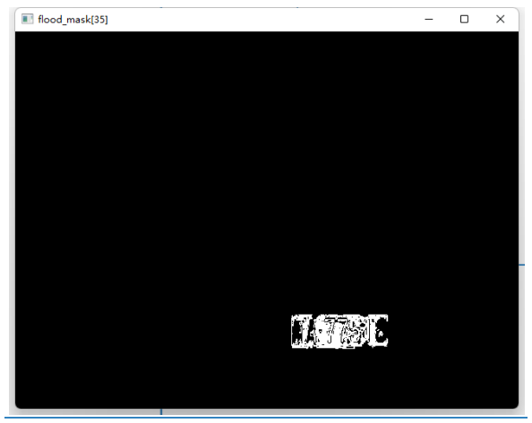
Code analysis – locate car plate
Flitter the possible rectangle
Find the mini area rectangle
Verify car plate by scale
Verify car plate by color
Find the column range and row range
Adjust the angle of the rectangle
Flood fill the area
Get the mask area
Transform the image if there is an angel
Adjust the size for CNN recognition

Slide 30
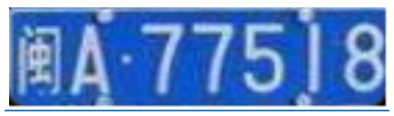

Code analysis – car plate recognition
Recognition of car plate
result index: 0 result probability: 0.9999999
Extract character
recognize character
horizontal projection
filter the one that exceeds the limit
project to Y to get the continuous length
get the total projection length
get the biggest length projection
cut into a single character

Slide 31
reference
https://blog.csdn.net/jmh1996/article/details/88951797
https://en.wikipedia.org/wiki/Convolutional_neural_network
https://en.wikipedia.org/wiki/TensorFlow
https://easyai.tech/en/ai-definition/cnn/
《Towards End-to-End License Plate Detection and Recognition: A Large Dataset and Baseline》

Slide 32
THANK YOU!
XIAOCHONG LIN
CS584 spring 2022 project presentation

